Slide 1
Todays Resuls

Slide 2
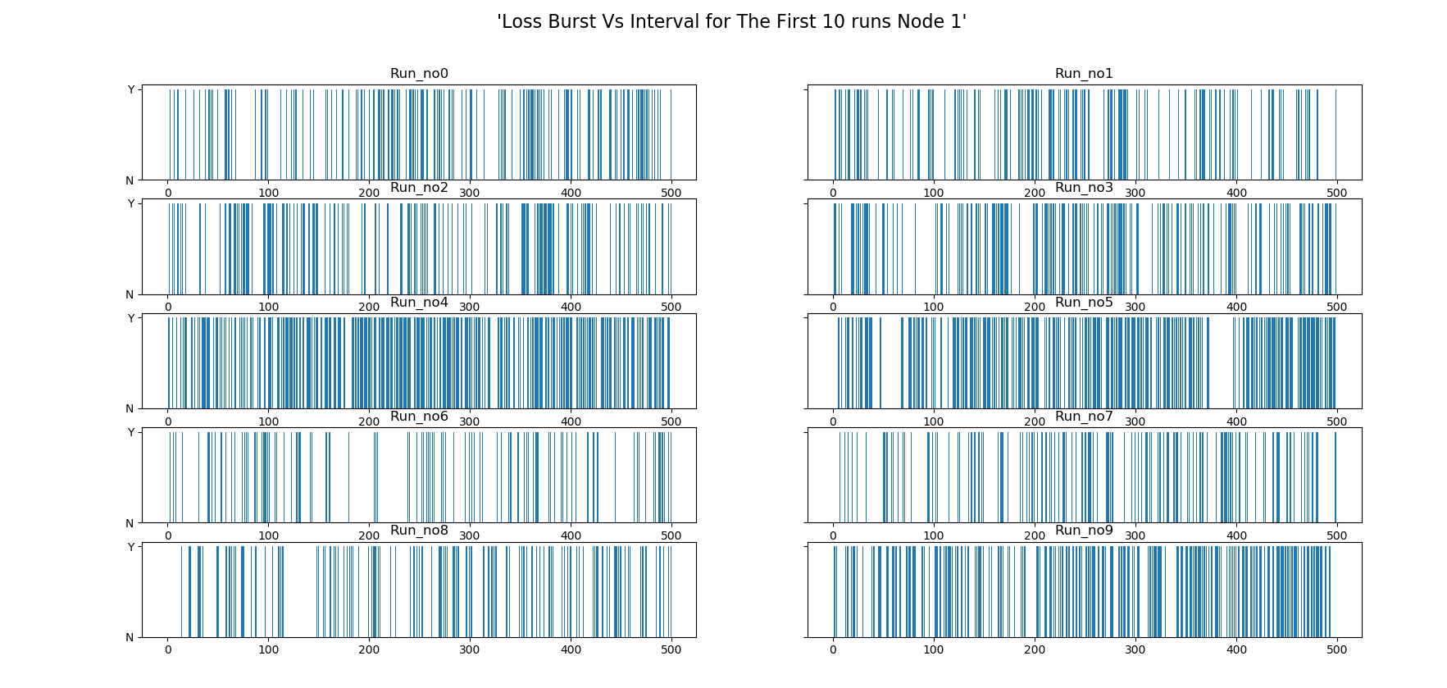

Slide 3
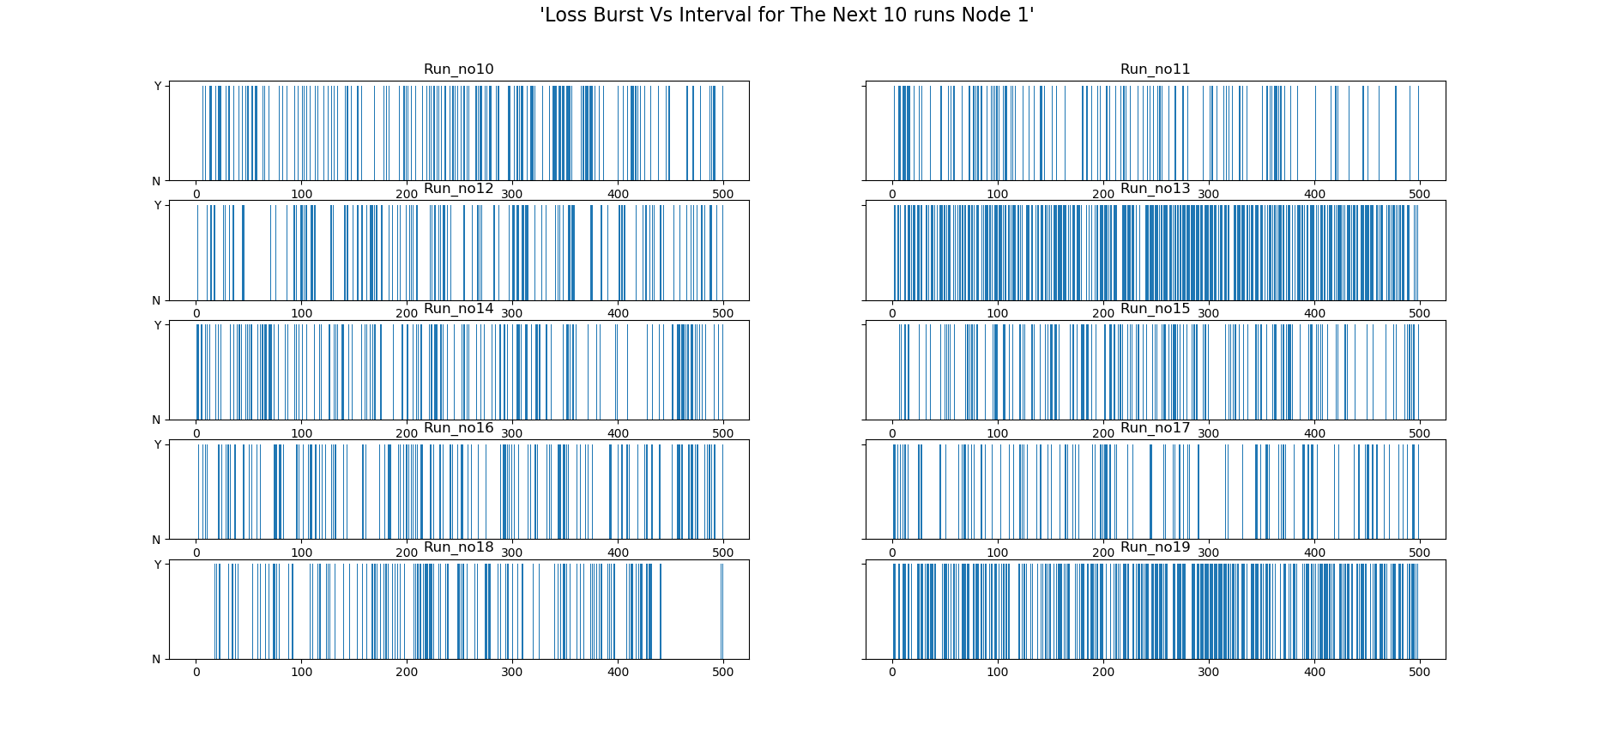

Slide 4
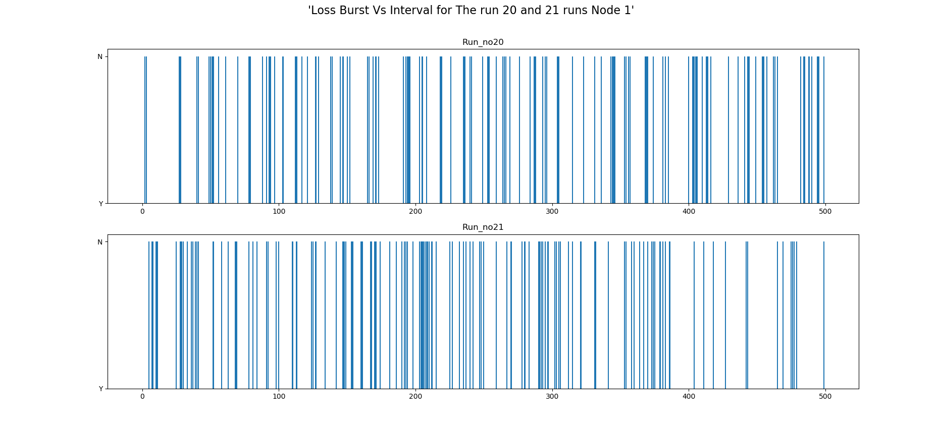

Slide 5
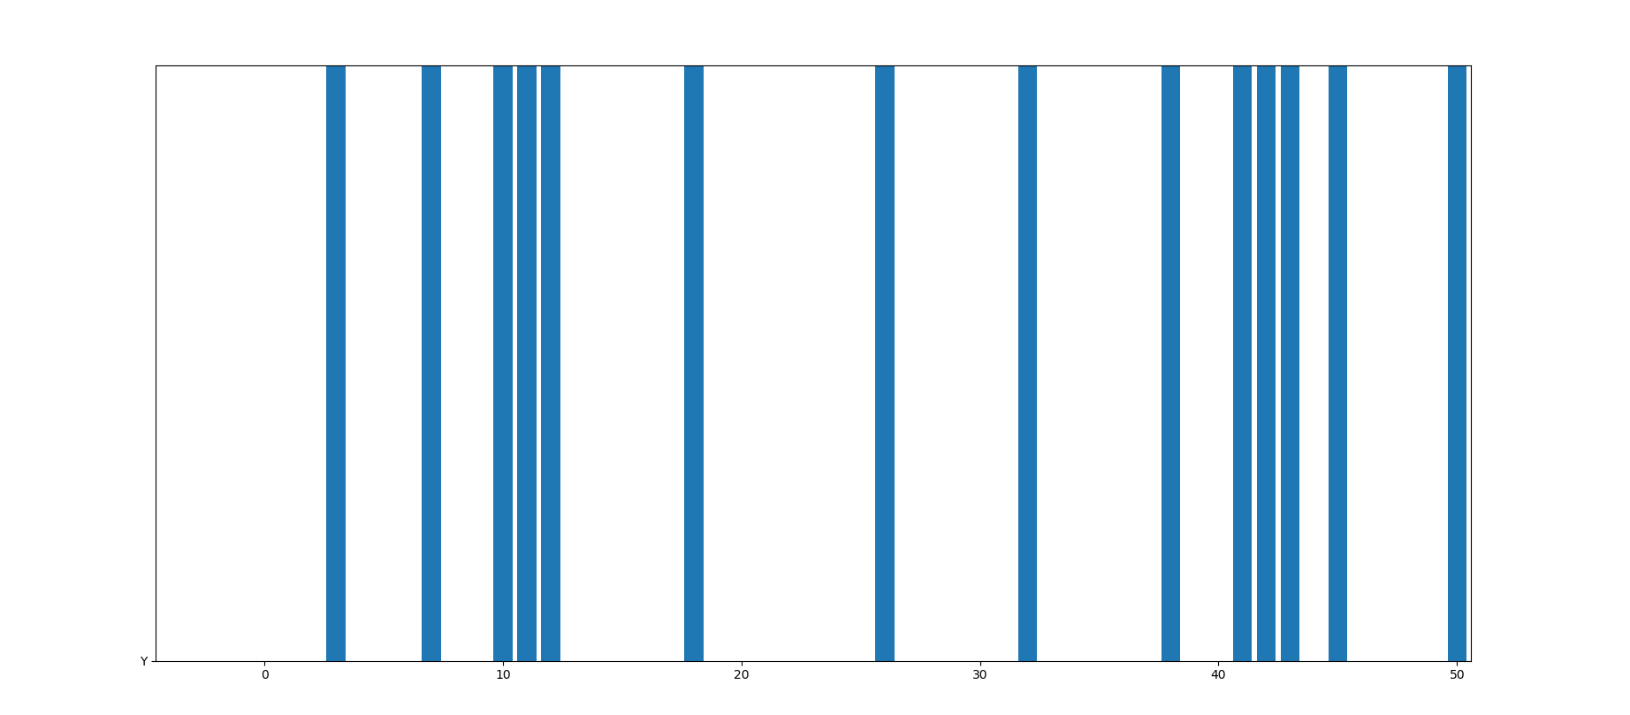
First 50 Frames for Run 1 Node 1

Slide 6
